Slide 1
Mobile Computing Technology
January 13, 2025

Slide 2
Introduction
Notes:
ISSN 1431-875X ISSN 2197-4136 (electronic)
Springer Texts in Statistics
ISBN 978-1-0716-1417-4 ISBN 978-1-0716-1418-1 (eBook)
https://doi.org/10.1007/978-1-0716-1418-1

Slide 3
Learning Objectives
Android / Linux

Slide 4
Android
What is

Slide 5
Definition
Linux is a fully open source operating system,
Linux’s kernel started as a Master's Thesis of Linus Torvalds
Has since gained worldwide fame and adoption
Available on many architectures including Standard IBM PC, ARM, MIPS and PowerPC architectures

Slide 6
Android
Built on top of Linux, but modifies it in substantial ways
Provides a full software stack
a self-contained GUI environment
a rich set of frameworks – a prewritten, well-tested code to access advanced functionality - such as cameras, motion sensors, GUI widgets and more - in a few lines of code
Java ad Kotlin as simple to use development languages
Google maintains the frameworks and runtime of the AOSP (Android Open Source Project)

Slide 7
Android/Linux
A safe estimate would be that Android and Linux are about 95% alike at the kernel level, and about 65% or so at the user-mode
What is a kernel?

Slide 8
Android/Linux
At the user-mode level, there is more of a divergence
introducing two entirely new components
the Dalvik runtime and
the Hardware Abstraction Layer
replacing glibc with Bionic,
providing a custom version of the init -- the system startup daemon.
The underlying OS, however, still remains for the most part unmodified, with native binaries, processes and threads behaving as on Linux.

Slide 9
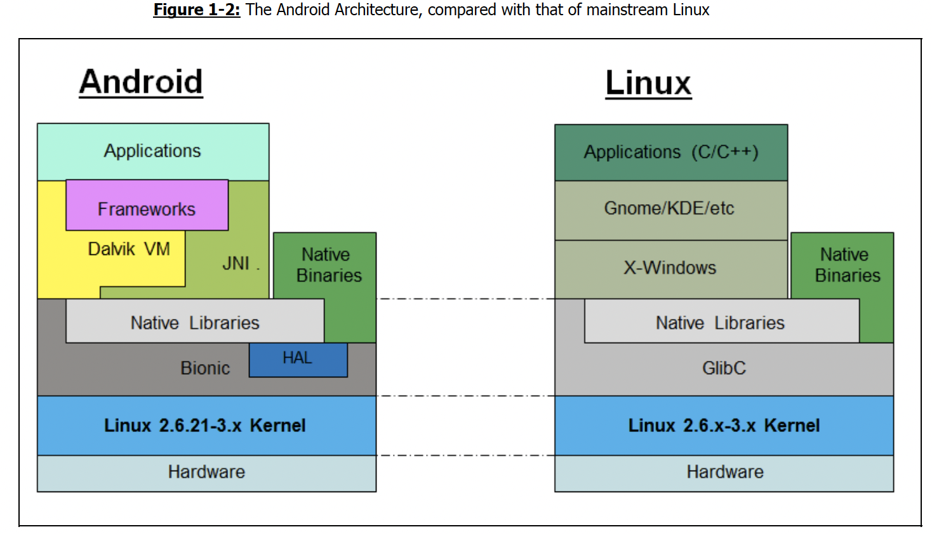
Android/Linux

Slide 10
Terms
Discuss the unknown

Slide 11
Clarifying terms
OS
Kernel
Unix
Glibc
Hardware Abstraction Layer
The init
Open Source Project
GUI / Widgets
Native binaries
Processes and Threads
????

Slide 12
Android Frameworks
What are

Slide 13
Android Frameworks
By providing the frameworks, Android facilitates the application creation process,
allowing developers to use higher-level languages such as Java, rather than low-level C/C++.
Developers can draw on the plentiful APIs which handle graphics, audio and hardware access.
Unlike X-Windows and GNOME/KDE, Android’s graphics programming API are far simpler
Notes:
Android owes a key part of its success to its rich set of frameworks.

Slide 14
Android Frameworks
Packaged in different namespaces, according to their functionality.
Packages in the android.* namespace are available for use by developers.
Packages in com.android.* are internal.
Android also supports most of the standard Java runtime packages in the java.* namespace
The entire set of frameworks is bundled into several Java ARchive (.jar) files on the device, in the directory names /system/framework
Notes:
Based on the Android version and actual Android device, the location of files and the name of the directories may vary (unfortunately!)

Slide 15
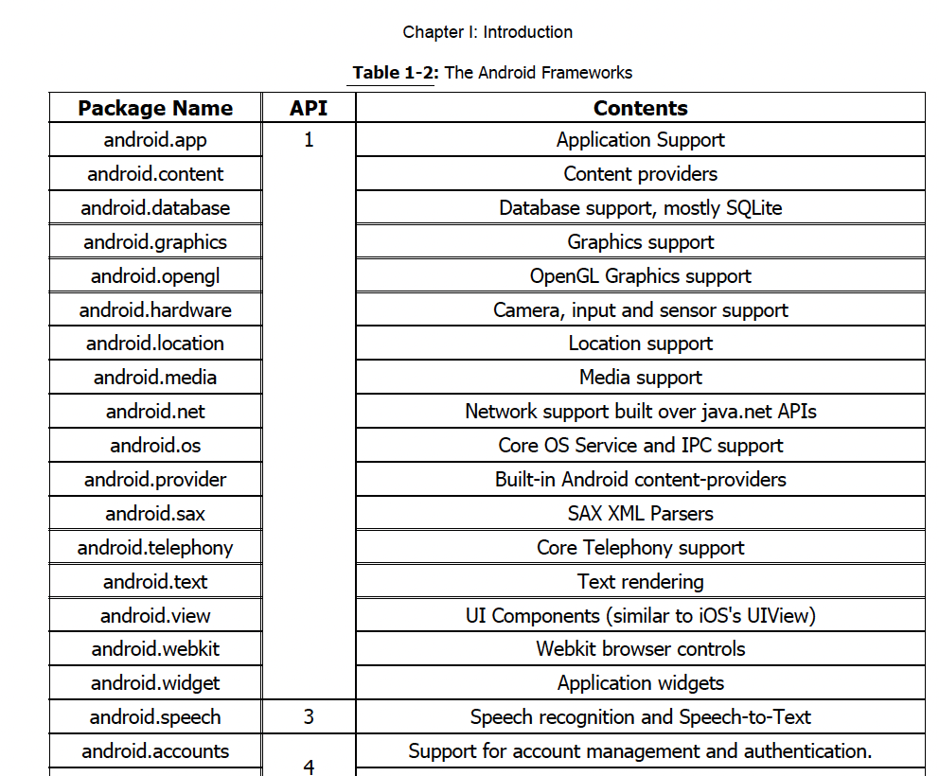
Android Frameworks
Notes:
Android owes a key part of its success to its rich set of frameworks.

Slide 16
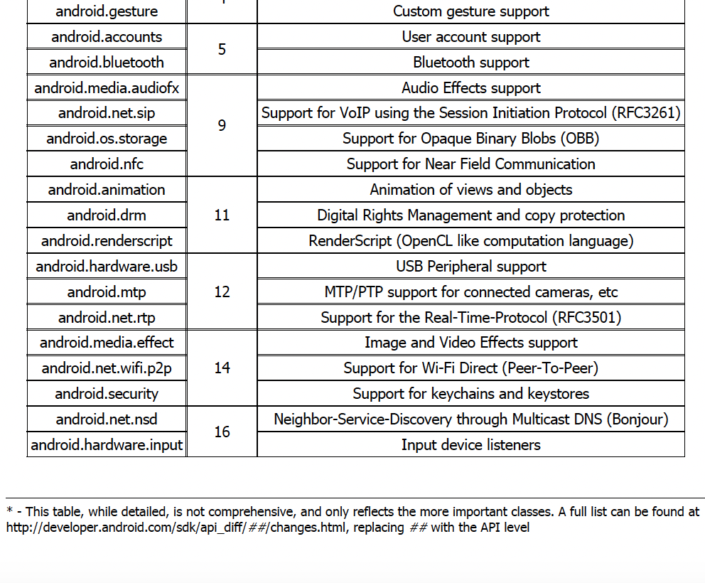
Android Frameworks (cont.)
Notes:
Android owes a key part of its success to its rich set of frameworks.

Slide 17
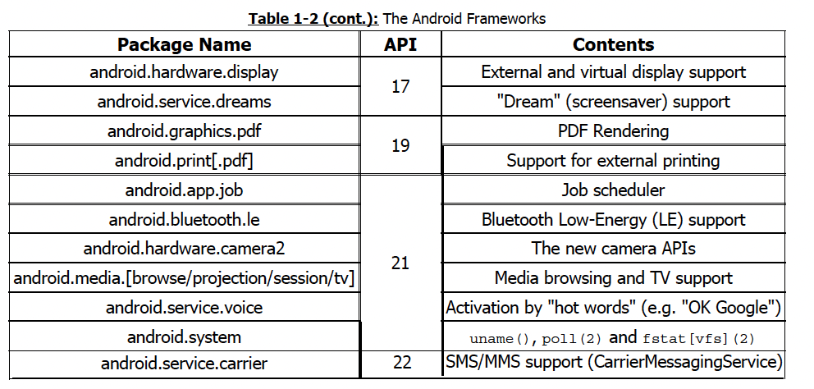
Android Frameworks (cont.)
Notes:
Android owes a key part of its success to its rich set of frameworks.

Slide 18
Discussion
namespaces
Java
Software packages in Java
Standard Java runtime packages
Just Google the terms or check Wikipedia and answer (your best guess is just fine)

Slide 19
Dalvik VM
The

Slide 20
Dalvik VM and Android RunTime
A notable addition to Linux is the introduction of the Dalvik Virtual Machine.
Android Applications run in the virtual machine
Similar to a Java VM
it runs a different form of bytecode (called DEX, for Dalvik Executable),
is more optimized for efficiency and sharing memory than the JVM designed by Sun/Oracle.
is based on a free open source clone of JVM.
Notes:
Dalvik is being superseded by the Android RunTime (ART), replacing the Just-In-Time (JIT) compilation aspect of Dalvik and keeping the file format (DEX) and the key architectural concepts of Dalvik
Android Applications run in the virtual machine, but at times need to escape it - usually to access hardware or other device (or chipset) specific features.
Dalvik therefore allows the inclusion of native libraries (ELF shared objects) in application code, through the Java Native Interface (JNI).

Slide 21
Android RunTime
The main layer in Android - Dalvik - involves significant processing, and even its many enhancements (e.g JIT compilation) still require much more work than native code would.
Rather than using a VM and JIT compilation, the Android RunTime (ART) uses Ahead-of-Time (AOT) compilation.
Higher Performance

Slide 22
Java Native Interface
Allows the inclusion of native libraries in application code, through the Java Native Interface (JNI)
e.g., C code written to access the graphics chip on a particular mobile device
Non native code are written to run on the VM and are agnostic to the underlying architecture (e.g., Intel, ARM, MIPS), providing greater portability of apps across various mobile devices.
Google provides the Native Development Kit (NDK) which developers can use to build native libraries
Notes:
Non-native Android applications run on the VM; They run universally - on Intel, ARM, MIPS, and other architectures - with no modification needed.
However, the VM has limitations when it comes to support hardware dependent software (e.g. graphics apps).
Thus, it is often necessary to directly interface with the hardware using native software libraries.

Slide 23
Discussion
Virtual Machine
Executable

Slide 24
Native Binaries
What are

Slide 25
Native Binaries
Android's critical system component are implemented in C/C++, and are compiled into native binaries.
User applications are compiled into Dalvik bytecode,
the bytecode runs in the context of a Dalvik Virtual machine
The VM itself is an ELF binary
Binaries are usually located in /system/bin,
and /system/xbin
with a few critical binaries located in /sbin.
Notes:
From the Linux perspective, all executables are ELF binaries
Because ELF is a standard file format, you can use any of the Linux ELF parsing tools (such as readelf or objdump) or other tools to handle the Android binaries.

Slide 26
Discussion
The file/directory hierarchy in Unix
What is the root directory ‘/’?
Open your VM (Lubunto)
Open a terminal
type
cd /
type ‘ll’ or ‘ls –a’ and then hit Enter

Slide 27
Bionic
What is

Slide 28
Glibc and Bionic
When you develop a C code and want to use some functions you typically #include <stdlib.h> and other headers
When you build your code the libc.so is linked to your output file
Linux distributions use GNU's LibC (GLibC) as their core runtime (the binary library file named libc.so),
Android elects to use its own C-runtime library, which is called Bionic.
Notes:
The implementation of many functions that we use in our C code are found in that libc.so file

Slide 29
Glibc and Bionic
Bionic
simpler and more lightweight than GlibC
more efficient for Android’s purposes, leaving out features deemed unnecessary or too complicated
Omits some system calls
No support for UNIX System V Interprocess Communication, including semaphores and shared memory. Android provides it’s own version of shared memory and an IPC concept called Binder
Notes:
What is IPC.

Slide 30
Glibc and Bionic (cont.)
Bionic
Pthread support is built-in to Bionic, but limited functionality
No support for Thread cancellation, i.e., pthread_cancel() is not supported
Mutex is not supported
C++ Exceptions are not supported. The C++ Standard Template Library not supported
Notes:
the VM has its own thread management and Unicode support (via ICU).
These omissions do, however, pose challenges to native code developers, especially those who seek to port libraries and executables from Linux to Android

Slide 31
Glibc and Bionic (cont.)
System Properties: Properties are a unique feature of Android, which allow both the system as well as applications to supply various configuration and operational parameters in a simple key/value store.
Device Name
Path variables
Android relies heavily on this mechanism, which is supplied through a shared memory region, accessible and read-only to all processes on the system, but settable only through /init.

Slide 32
HAL
What is the Android

Slide 33
Hardware Abstraction Layer
Android defines a Hardware Abstraction Layer (HAL) which aims to promote standardization by defining an adapter
The Hardware Abstraction Layer defines what an abstract camera, GPS, sensor, and other components look like to Android
Hardware vendors must conform to the interface Android expects.
Notes:
Android is meant to run on so many types of different devices
The underlying hardware may greatly differ in its scope and support

Slide 34
Device Storage
The Android

Slide 35
Device Storage in Android
The device's storage is broken up into disjoint chunks, each of them individually formatted and purposed.
Chunks are called ‘partitions’
/system is where the OS itself is installed
/data is where user data is stored,
Linux pseudo-filesystems
not a part of Android; serve important functions during system operation, primarily for diagnostics and hardware access
Notes:
not all partitions are actually mounted by Android: In fact, only a scant few often are, with the remainder either meant for use during recovery, or exclusively by system components.
The latter are also unmountable by definition, because they often contain proprietary formatting, which the Linux kernel does not recognize

Slide 36
Partitions
cd /proc
the file /proc/partitions contains information about the available partitions (the the partition map)
Alternatively, you can use the df command to explore the partitions that are mounted
A partition must be mounted before it is visible / accessible

Slide 37
Classroom Experiments
Install Android Studio
Pair your phone with Android – Check Android Manuals on How to Pair your phone with your computer
Follow classroom instructions; You need to make ‘developer options’ visible on your android phone. Then enable ‘USB debugging’; Then open Android Studio; Then pair the phone.
Then find where you have installed the Android ‘plattform-tools’
Then connect your phone with a USB cable to your computer
Then try the command-line instruction: ./adb shell
It will automatically give you a shell on the device that is paired with your computer
Notes:
Please install Android SDK and Android ADB
Follow the following website to run the emulator and enter it using ADB
Android Debug Bridge (adb) | Android Studio | Android Developers
Android is meant to run on so many types of different devices
The underlying hardware may greatly differ in its scope and support

Slide 38
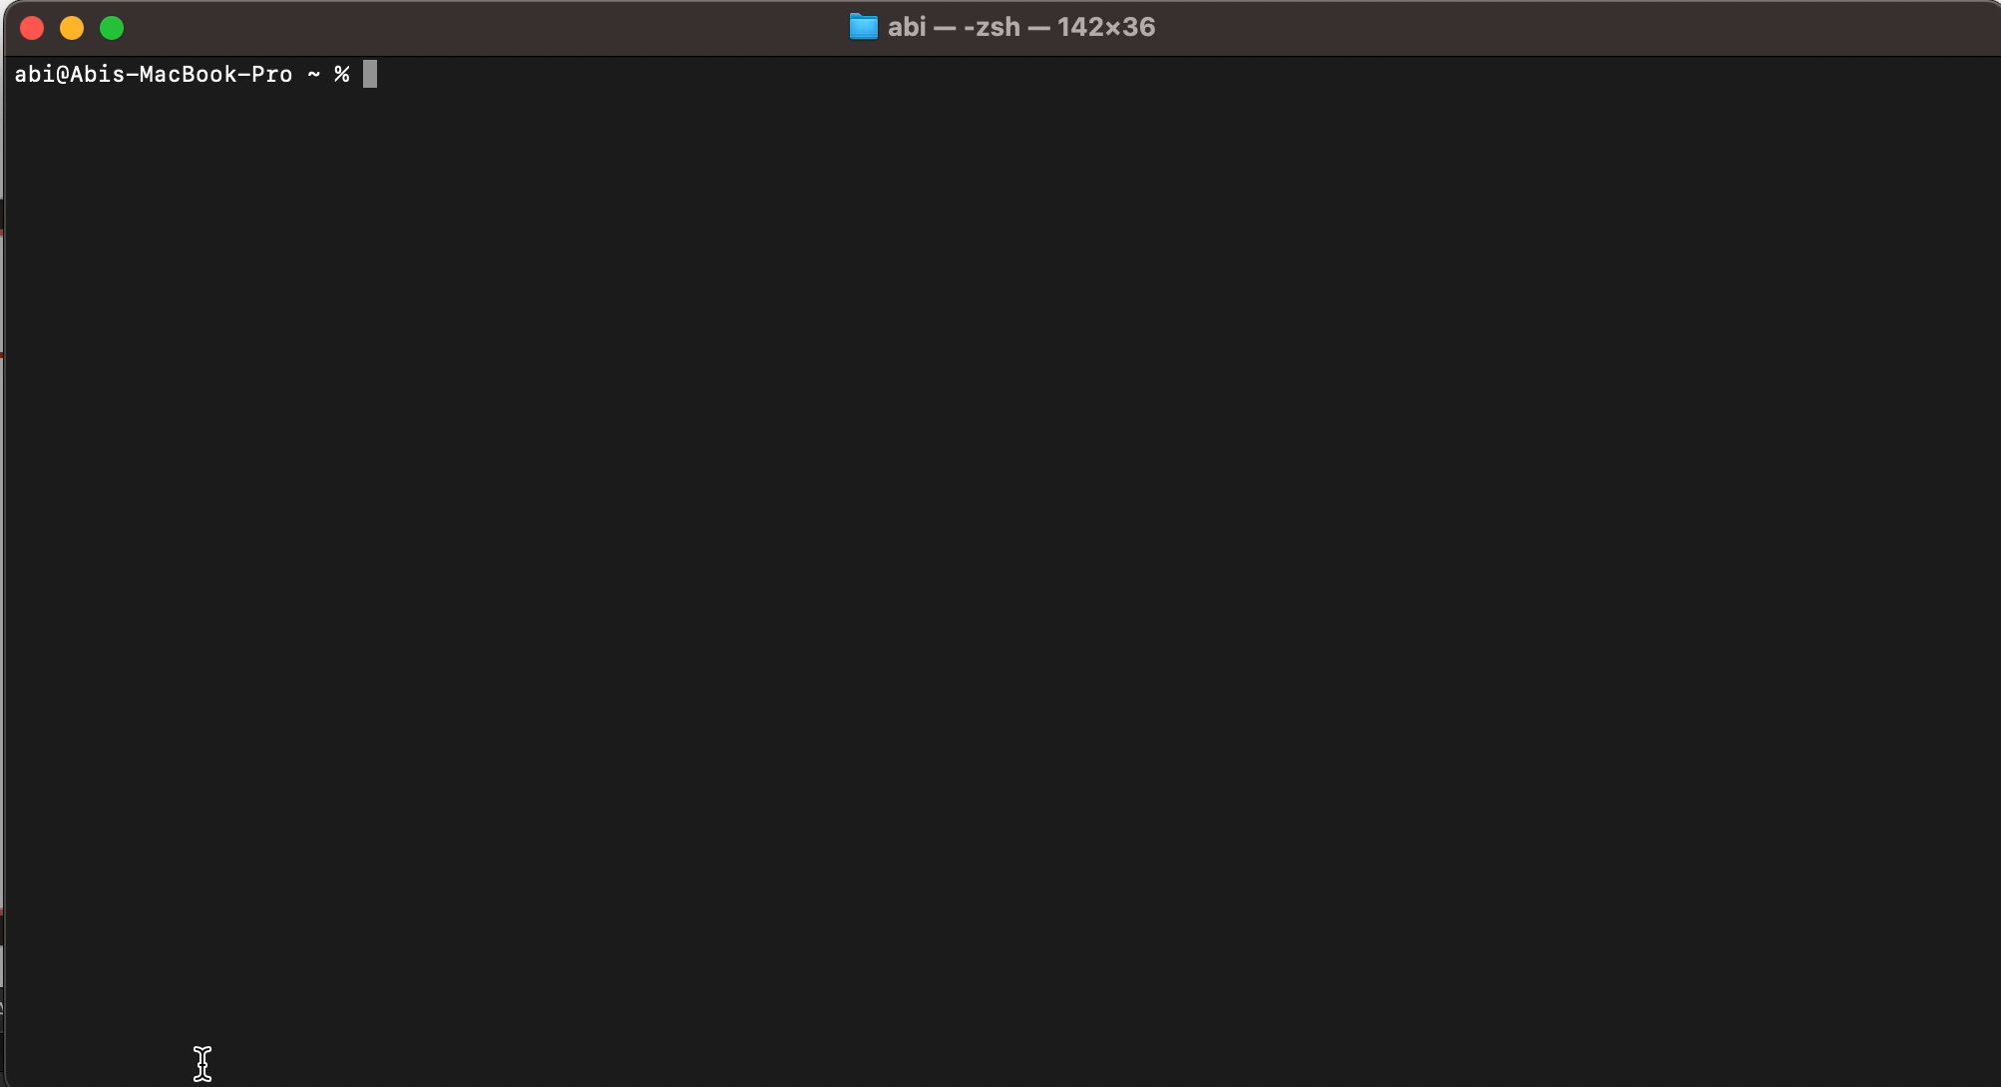
Classroom Experiments (cont.)

Slide 39
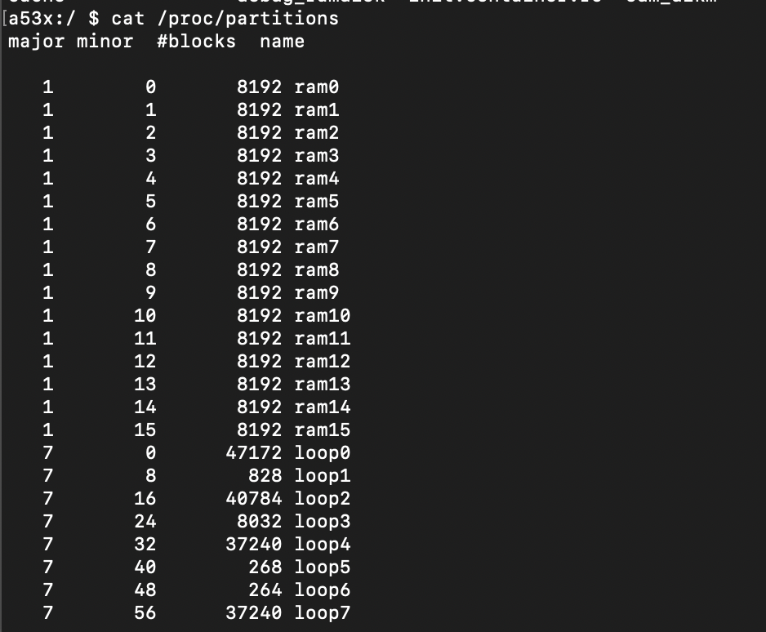
Classroom Experiments (cont.)
login into your device shell
type cat /proc/partitions
Notes:
Android is meant to run on so many types of different devices
The underlying hardware may greatly differ in its scope and support
Block are 512-byte (1/2K) blocks.
Telling apart the partitions just by their cryptic name is hard, but thankfully most devices have symbolic links, by-num and by-name, in the /dev/block/platform/name.# directory
use cd /dev/block/platform/13500000.ufs/by-name
Then type ls –l and press enter

Slide 40
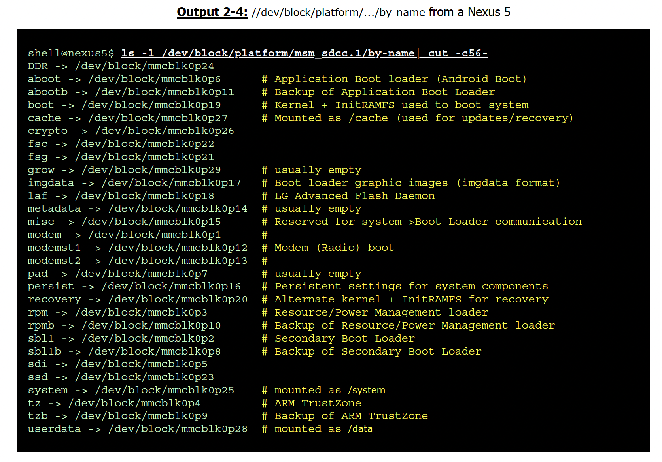
Classroom Experiments (cont.)
login into your device shell
type cat /proc/partitions
Notes:
Note, that your local Android device partition names can and likely will vary.
As the previous experiment has shown, partitions on Android devices have set names, but most
of them are quick cryptic. To complicate matters, different device chipsets and vendors use different
partitions, as well as different names for the same functional partitions.

Slide 41
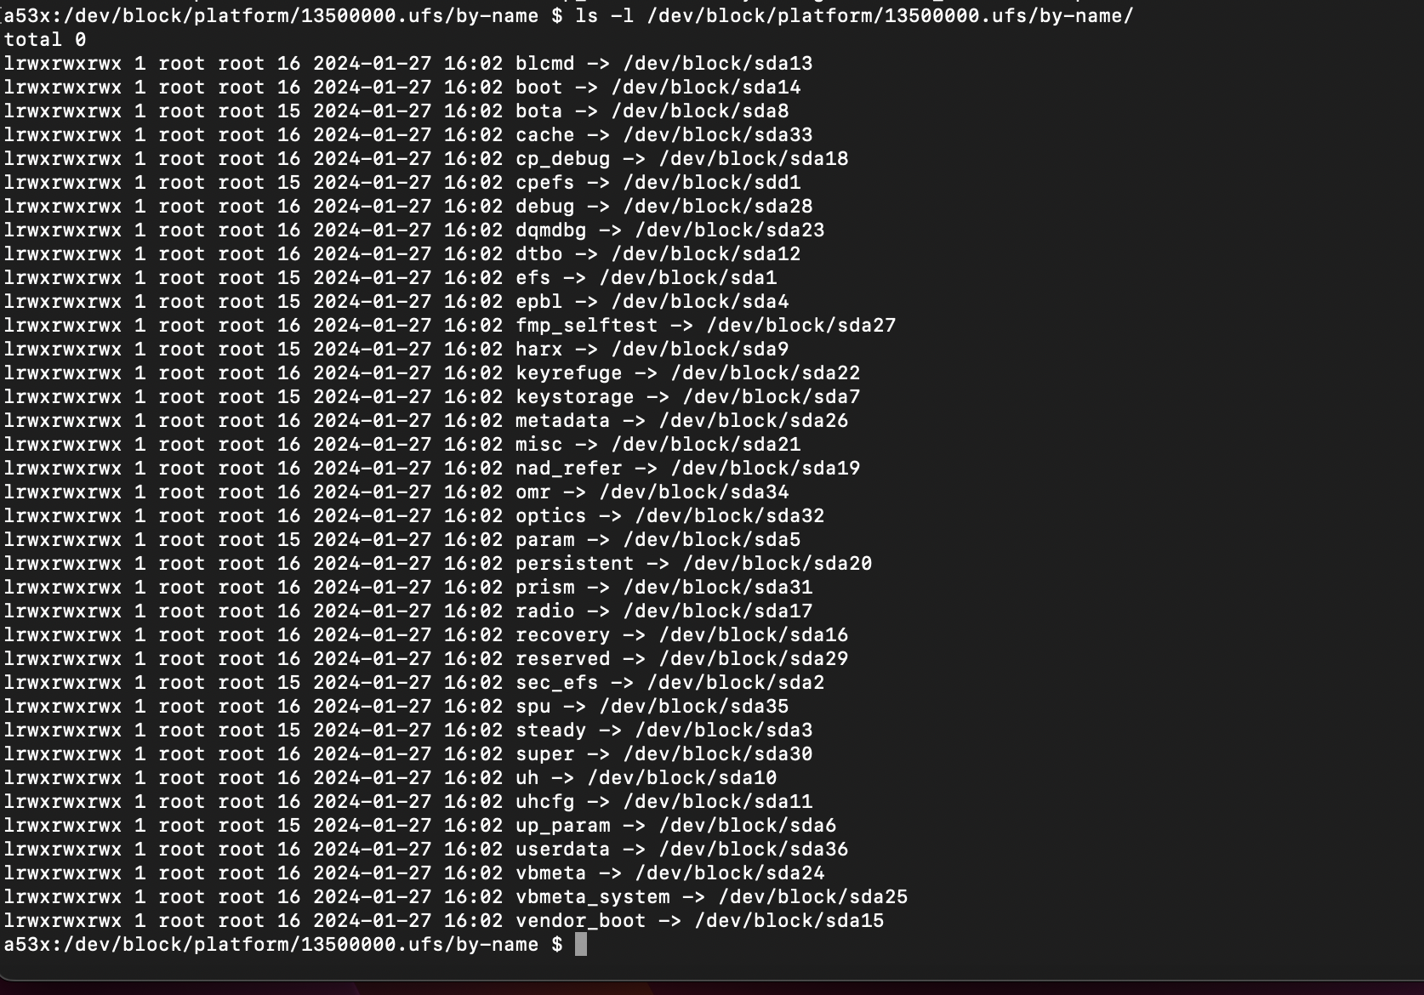
Classroom Experiments (cont.)
Notes:
this is on my phone; on your phone the names will vary

Slide 42
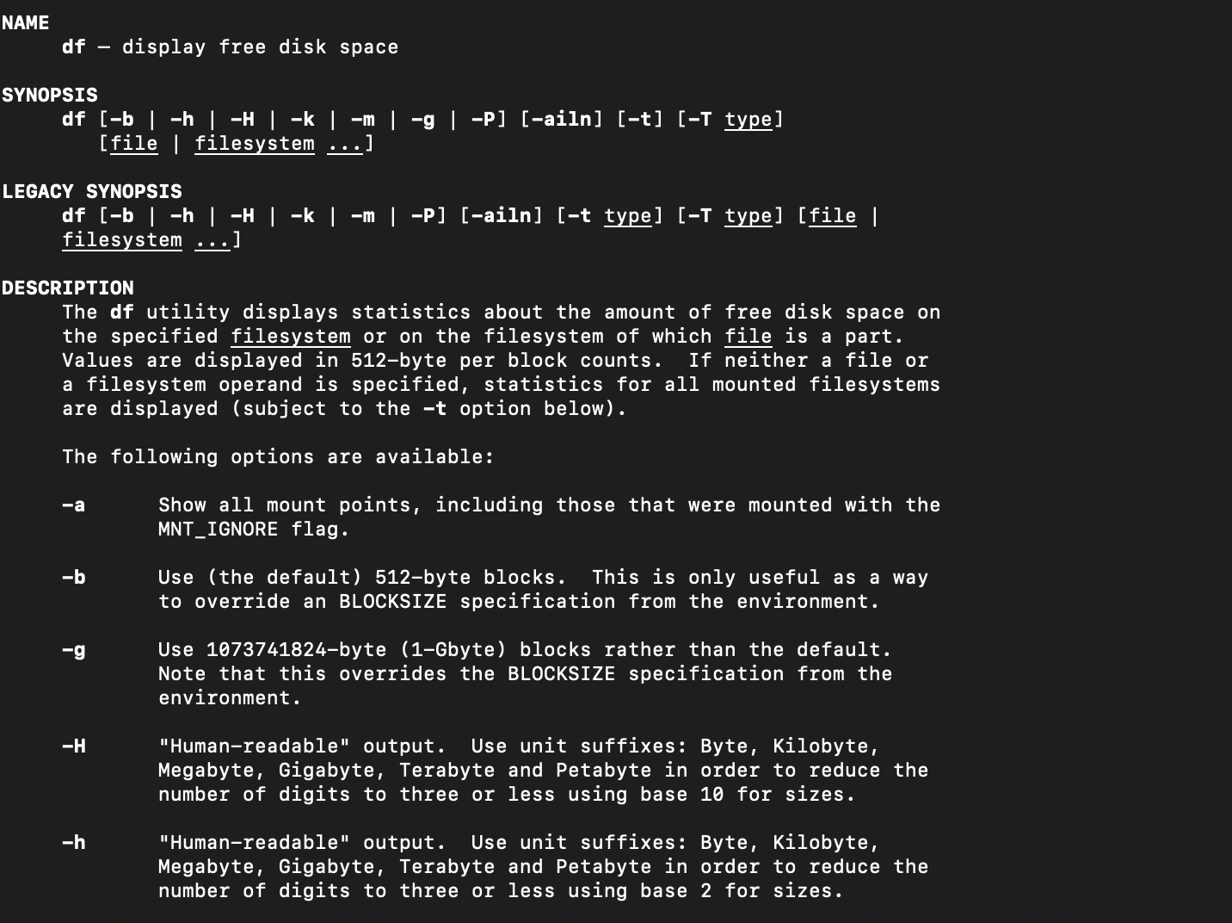
Classroom Experiments (cont.)
Notes:
use df to display free disk space

Slide 43
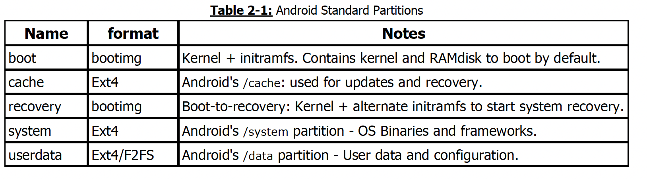
Android Device Partitions
Partitions on Android devices have set names, but most of them are quick cryptic. To complicate matters, different device chipsets and vendors use different
partitions, as well as different names for the same functional partitions.
Notes:
These partitions comprise the core of the OS. The standard partitions are mostly mountable, with the exception of the boot and recovery partitions, which are (commonly) formatted with Android's proprietary bootimg format
Android devices contain a file system mounting table in /system/etc/vold.fstab or /system/etc/fstab.postinstall
These partitions are loaded by the Volume Daemon during system startup, and provides the partitions which are to be mounted automatically.
The kernel maintains a list of all supported filesystems in /proc/filesystems

Slide 44
Android Device Partitions
try on Samsung
cat /system/etc/fstab.postinstall
The kernel maintains a list of all supported filesystems in /proc/filesystems
cd /dev/block/platform/13500000.ufs/by-name/
ls -l | cut -c43-
Notes:
your local Android device partition names can and likely will vary

Slide 45
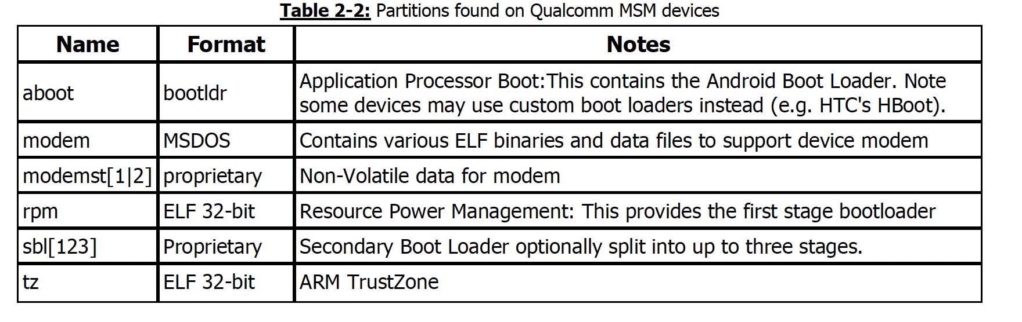
Chipset-specific Partitions
Chipset vendors often require dedicated partitions for their components
Notes:
The most notable example is Qualcomm, whose MSM chipset (arguably the most popular) uses the partitions shown in table 2-2.

Slide 46
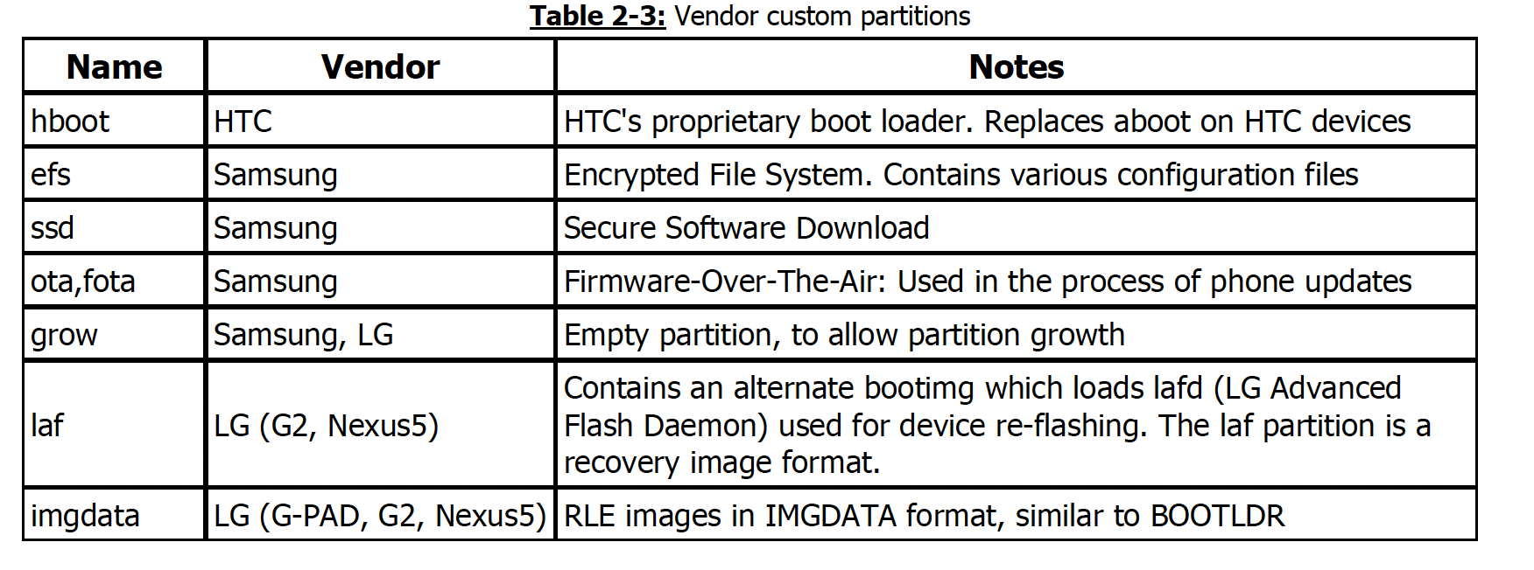
Vendor-specific Partitions
Notes:
The rest of the partitions (i.e., other than Android Standard Partitions boot, cache, recovery, system, userdata as well as chipset specific partitions) found on an Android device are specific to vendors, who use custom partitions for their own purposes, mostly device configuration maintenance or upgrade operations. The formatting used is often proprietary

Slide 47
blcmd -> /dev/block/sda13
boot -> /dev/block/sda14
bota -> /dev/block/sda8
cache -> /dev/block/sda33
cp_debug -> /dev/block/sda18
cpefs -> /dev/block/sdd1
debug -> /dev/block/sda28
dqmdbg -> /dev/block/sda23
dtbo -> /dev/block/sda12
efs -> /dev/block/sda1
epbl -> /dev/block/sda4
fmp_selftest -> /dev/block/sda27
harx -> /dev/block/sda9
keyrefuge -> /dev/block/sda22
keystorage -> /dev/block/sda7
metadata -> /dev/block/sda26
misc -> /dev/block/sda21
nad_refer -> /dev/block/sda19
omr -> /dev/block/sda34
optics -> /dev/block/sda32
param -> /dev/block/sda5
persistent -> /dev/block/sda20
prism -> /dev/block/sda31
radio -> /dev/block/sda17
recovery -> /dev/block/sda16
reserved -> /dev/block/sda29
sec_efs -> /dev/block/sda2
spu -> /dev/block/sda35
steady -> /dev/block/sda3
super -> /dev/block/sda30
uh -> /dev/block/sda10
uhcfg -> /dev/block/sda11
up_param -> /dev/block/sda6
userdata -> /dev/block/sda36
vbmeta -> /dev/block/sda24
vbmeta_system -> /dev/block/sda25
vendor_boot -> /dev/block/sda15
a53x:/dev/block/platform/13500000.ufs/by-name $ ls -l | cut -c43-
Notes:
The rest of the partitions (i.e., other than Android Standard Partitions boot, cache, recovery, system, userdata as well as chipset specific partitions) found on an Android device are specific to vendors, who use custom partitions for their own purposes, mostly device configuration maintenance or upgrade operations. The formatting used is often proprietary

Slide 48
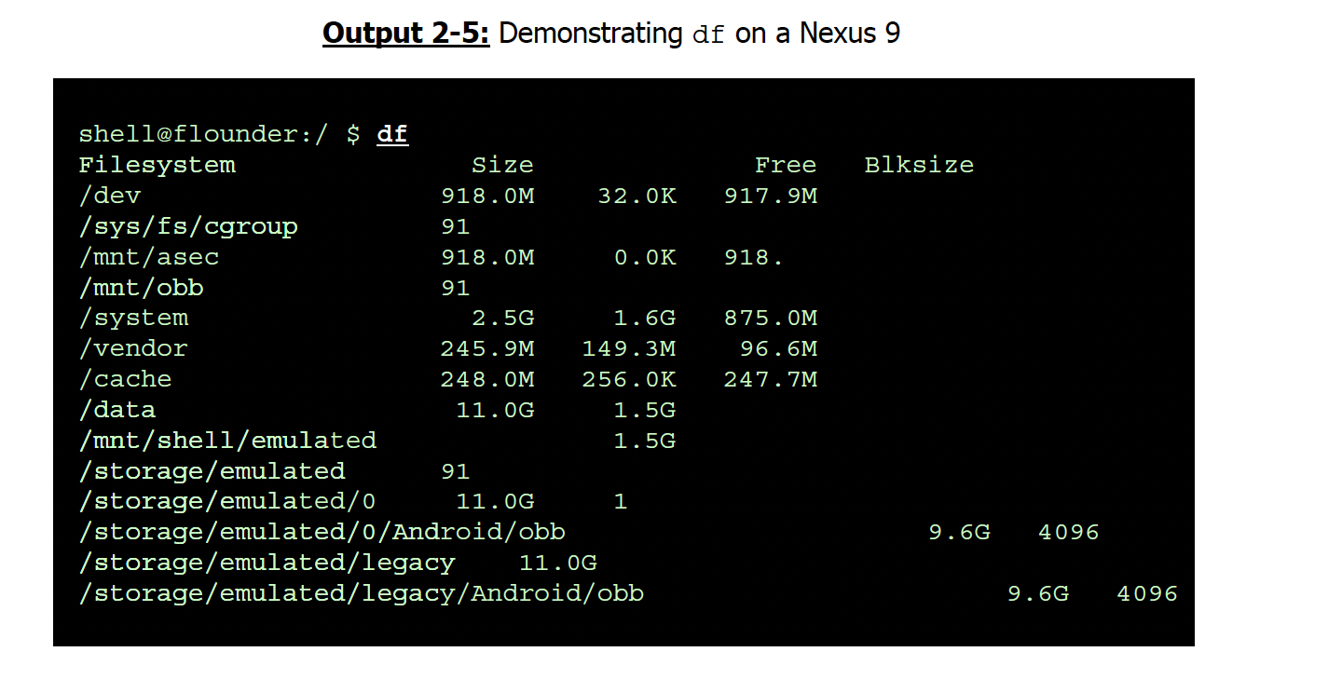
Classroom Experiment
The "disk free" command shows total/used/available disk space for
each filesystem listed on the command line, or all currently mounted
filesystems.
Notes:
df –H
Type the above command on your device shell
Check Google to read the manual for the df command

Slide 49
File System
The Android

Slide 50
File System
The file systems are exposed to us in form of a ‘tree’
The root is named ‘/’
It contains files and directories
Almost everything is a file
serial ports
network ports
shared memory
monitor
keyboard
sensors
....

Slide 51
File System
Directories can contain files or other directories
Root is a directory
You can switch to the root directory using the following command
cd /
Devices, processes, drivers, system resources etc are made available in special directories

Slide 52
File System
The kernel maintains a list of all supported filesystems in /proc/filesystems
lists which filesystems are supported either natively (i.e. compiled into the kernel) or as a loaded module
Android's root file system is mounted from a RAM Disk (the "initramfs"). Upon every boot, the boot loaderder loads the filesystem image from the boot partition onto RAM, and provides it for the kernel.
Notes:
the root filesystem image cannot be easily modified because the root filesystem contains the most important
component of the system in the /init directory which runs as root, and controls the system startup.

Slide 53
File System
Directory | Notes
/init | The binary launched by the kernel on startup as PID 1
fstab.hardware | The filesystem mount table used by fs_mgr
init[...].rc | The configuration file(s) for /init. The main configuration file is always /init.rc, with optional additional files which are device and vendor dependent
sbin/ | Contains critical binaries, such as adbd, healthd and (most importantly) recovery, which the system needs even if /system cannot be mounted. May also contain vendor binaries.
Notes:
the root filesystem image cannot be easily modified because the root filesystem contains the most important
component of the system in the /init directory which runs as root, and controls the system startup.

Slide 54
File System
Directory | Notes
/init | The binary launched by the kernel on startup as PID 1
fstab.hardware | The filesystem mount table used by fs_mgr
init[...].rc | The configuration file(s) for /init. The main configuration file is always /init.rc, with optional additional files which are device and vendor dependent
sbin/ | Contains critical binaries, such as adbd, healthd and (most importantly) recovery, which the system needs even if /system cannot be mounted. May also contain vendor binaries.
Notes:
the root filesystem image cannot be easily modified because the root filesystem contains the most important
component of the system in the /init directory which runs as root, and controls the system startup.

Slide 55
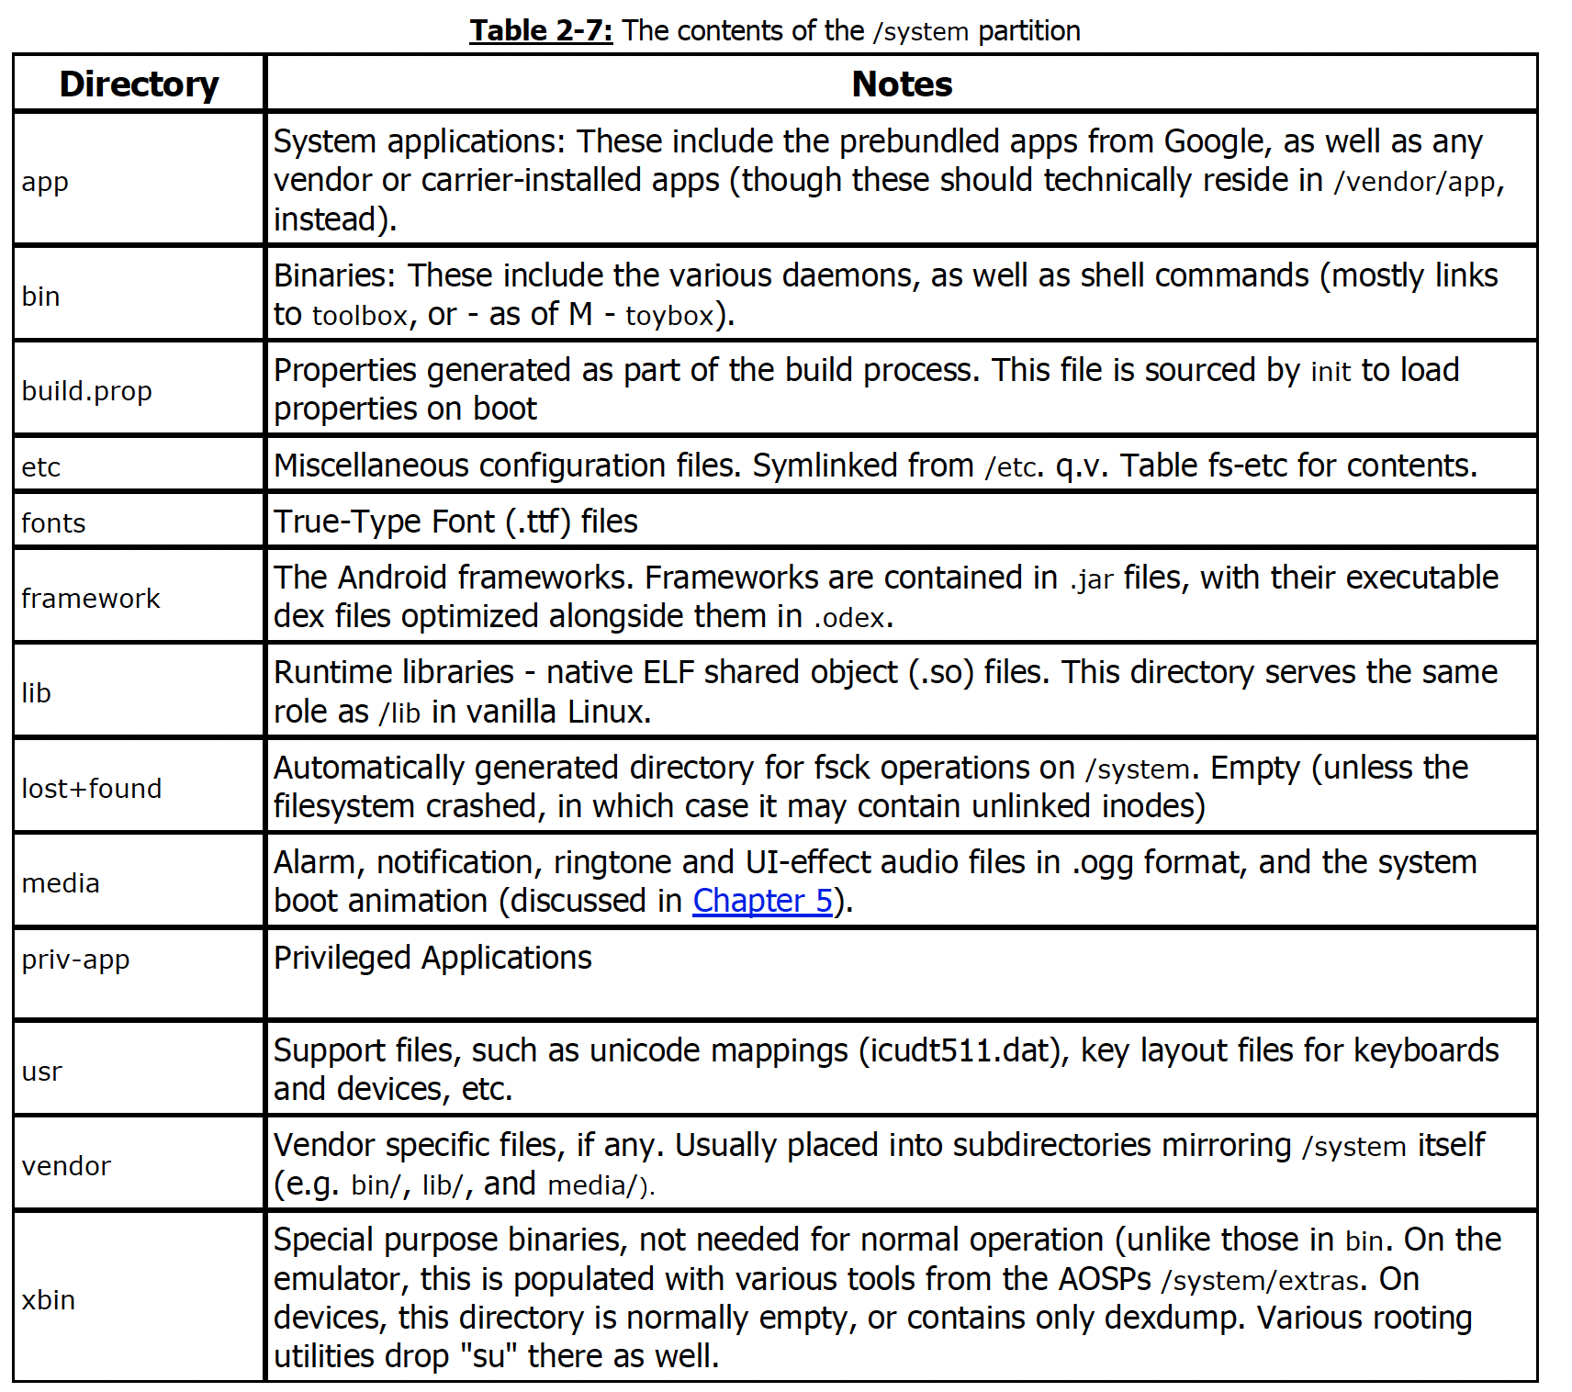
File System
Notes:
Table 2-7 shows the contents of the the /system partition you can expect on any Android device:
The /system partition is the home of all Android components, as provided by Google and/or the system vendor. The directory and its contents are owned by root:root, and all have permissions of 0755 (rwxr-xr-x), but the filesystem is mounted read-only.
In practice vendors and carriers sometimes add their own apps and (rarely) directories, rather than in /vendor, which is the location designed for that.

Slide 56
Summary
Linux/Android
Clarification of technical terms
Android Frameworks
Native Binaries
Bionic
Notes:
We will discuss Inference after discussing linear regression

